Slide 1
Cathepsin L in secretory vesicals functions as a prohormone-processing enzyme for production of the enkephalin peptide neurotransmitter.
Sukkid Yasothornsrikul*†, Doron Greenbaum†‡, Katalin F. Medzihradszky‡, Thomas Toneff§, Richard Bundey§, Ruthellen Miller§, Birgit Schilling§, Ivonne Petermann¶, Jessica Dehnert§, Anna Logvinova§, Paul Goldsmith§, John M. Neveu , William S. Lane , Bradford Gibson§, Thomas Reinheckel¶, Christoph Peters¶, Matthew Bogyo**††, and Vivian Hook*§††
Published in PNAS in 2003

Slide 2
Introduction
The biosynthesis of enkephalin opioid peptides as well as numerous peptide neurotransmitters and hormones requires proteolytic processing of respective proprotein precursors within regulated secretory vesicles (1–4).
The mature, processed enkephalin peptide is stored within these vesicles and undergoes stimulated secretion to mediate neurotransmission and cell–cell communication in the regulation of analgesia, behavior, and immune-cell functions.
Secretory vesicles of neuroendocrine chromaffin cells (also known as chromaffin granules) contain enkephalin and its precursor proenkephalin (PE) (5, 6), with relevant prohormone convertases for converting PE into active enkephalin.

Slide 3
Processing of Proneuropeptide or Prohormone Precursor

Slide 4
The primary PE-cleaving activity in chromaffin granules has been characterized as a cysteine protease complex known as‘‘prohormone thiol protease’’ (PTP) (7–10).
The cysteine protease activity cleaves PE and enkephalin-containing peptide substrates at paired basic residues, as well as at certain monobasic residues, to generate appropriate enkephalin-related peptide products.
Cellular inhibition of PTP by a cysteine protease inhibitor results in reduced production of enkephalin (11). Molecular identification of the protease component responsible for this cysteine protease activity will facilitate our understanding of multiple proteolytic enzymes that produce active peptides including the opioid [Met]enkephalin(ME) (12, 13).

Slide 5
In this study
the protease responsible for PE-cleaving activity in chromaffin granules was identified by using an activity-based probe for cysteine proteases (14, 15) combined with mass spectrometry (MS) for peptide sequencing. Results identified secretory vesicle cathepsin L as the enzyme responsible for the previously described PTP cysteine protease activity involved in enkephalin and neuropeptide production (7–10).
Cathepsin L generated the active peptide ME by cleaving enkephalin-containing peptide substrates at native dibasic and monobasic sites. Notably, cathepsin L colocalized with ME in the regulated secretory pathway of chromaffin cells.
In cathepsin L gene knockout (KO) mice (16–18), ME levels in brain were reduced significantly; an increase in relative amounts of enkephalin precursor also occurred.

Slide 6
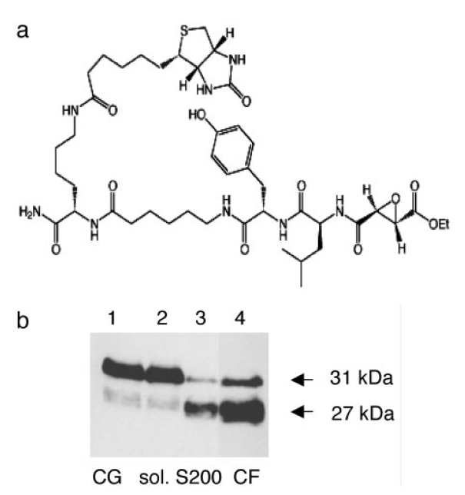
Results
Affinity labeling of PE-processing activity (PTP) in chromaffin granules.
Fig:1

Slide 7
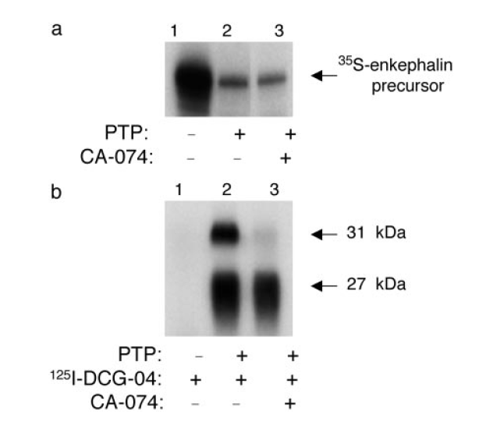
Fig:2

Slide 8
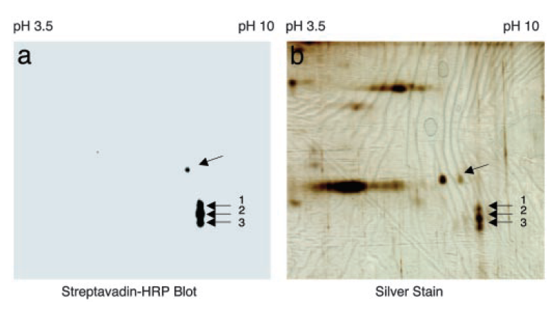
2. Peptide sequencing by MS Identifies Cathepsin L as the Cysteine Protease for PE Processing.
Fig: 3

Slide 9
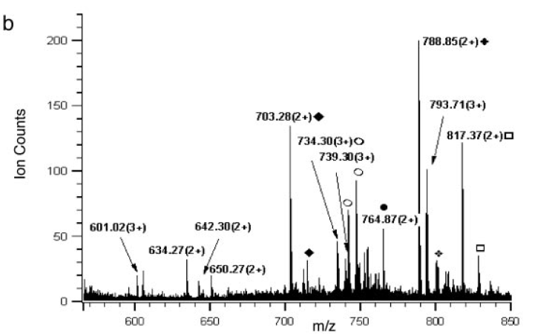
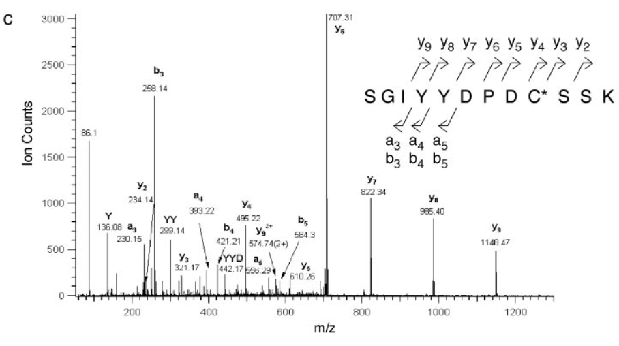
Fig:4
Bovine Cathepsin L identified by MS

Slide 10
3. Cathepsin L Cleaves Enkephalin-Containing Peptides at Dibasic and monobasic Prohormone-Processing Sites.
Fig: 5

Slide 11
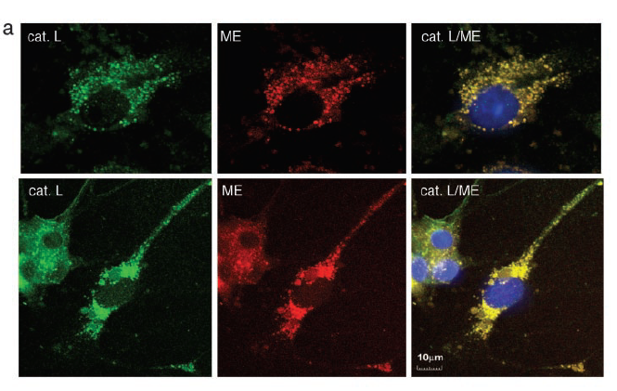
4. Cellular colocalixation of Cathepsin L with ME in Secretory Vesicles of Neuroendocrine Chromaffin Cells.
Fig: 6

Slide 12
Fig: 6

Slide 13
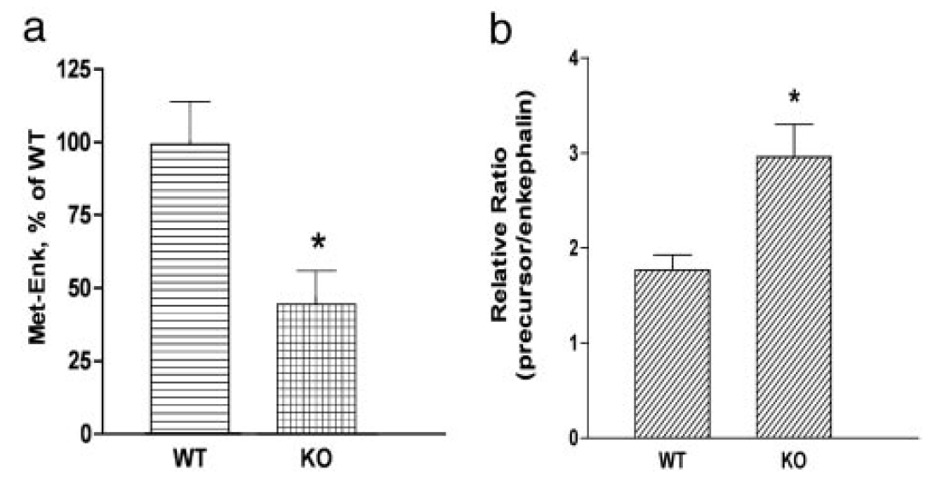
5.Cathepsin L Gene KO Mice Possess Reduced levels of ME in Brain.
Fig:7

Slide 14
Conclusion
Cathepsin L can be routed to secretory vesicles to generate products with distinct biological functions. In chromaffin cells, the high degree of colocalization of cathepsin L immunofluorescence with ME, confirmed by dual immunoelectron microscopy, demonstrates trafficking of cathepsin L to the regulated secretory pathway.
Importantly, the cathepsin L gene KO mice contain reduced levels of brain ME, which represents approximately one-half of that in WT control brains. These findings substantiate a role for cathepsin L in the production of neuronal ME in brain.

Slide 15
In summary, results from this study provide evidence for a previously uncharacterized biological function of cathepsin L for the production of ME in the regulated secretory pathway. Secretory vesicle cathepsin L represents a newly identified proteolytic processing enzyme for the production of active enkephalin and possibly other peptide neurotransmitters or hormones.

Slide 16
Thankyou☺

Slide 17
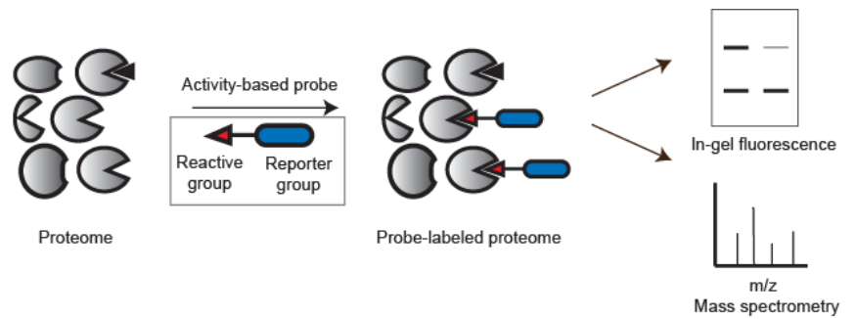
Activity Based Probe
Activity based probe are designed to react with only the active form of the enzyme, but not the inactive form like proenzyme.
Assay the activity of enzyme, but not amino acids or genetic sequences.
Investigates how enzyme activity differs between normal cell vs abnormal cells.

Slide 19
The secretory vesicle is a vesicle that mediates the vesicular transport of cargo - e.g. hormones or neurotransmitters - from an organelle to specific sites at the cell membrane, where it docks and fuses to release its content.

Slide 20
Cathepsin L
It is an important lysosomal endopeptidase enzyme which is involved in the initiation of protein degradation. It is a member of the Peptidase C1 family, which play an important role in diverse processes including normal lysosome mediated protein turnover, antigen and proprotein processing, and apoptosis.

Slide 21
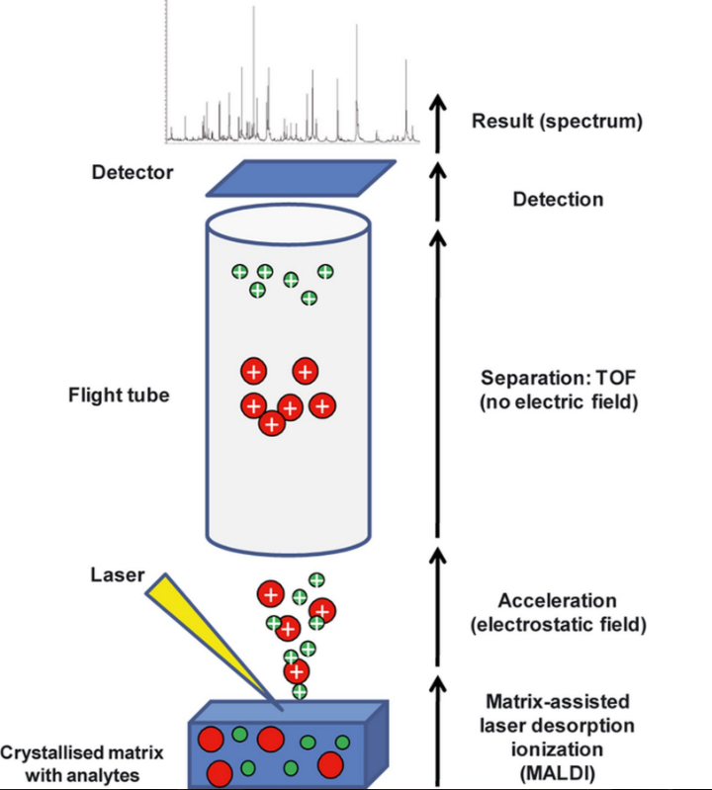
MALDI-TOF

Slide 22
2D gel electrophoresis (2DE)
is a key technique for purifying individual proteins from complex samples based on their isoelectric points and molecular weights.
Simple enough in theory, but as the plethora of protocols and articles shows, 2DE demands patience and meticulous optimization.

