Slide 1
Molecular determinants for the chemical activation of the warmth-sensitive TRPV3 channel by the natural monoterpenoid carvacrol
Canyang Niu, Xiaoying Sun, Fang Hu, Xiaowen Tang, KeWei Wang
Journal of Biological Chemistry
Volume 298 Issue 3 (March 2022)
DOI: 10.1016/j.jbc.2022.101706
Copyright © 2022 The Authors Terms and Conditions

Slide 2
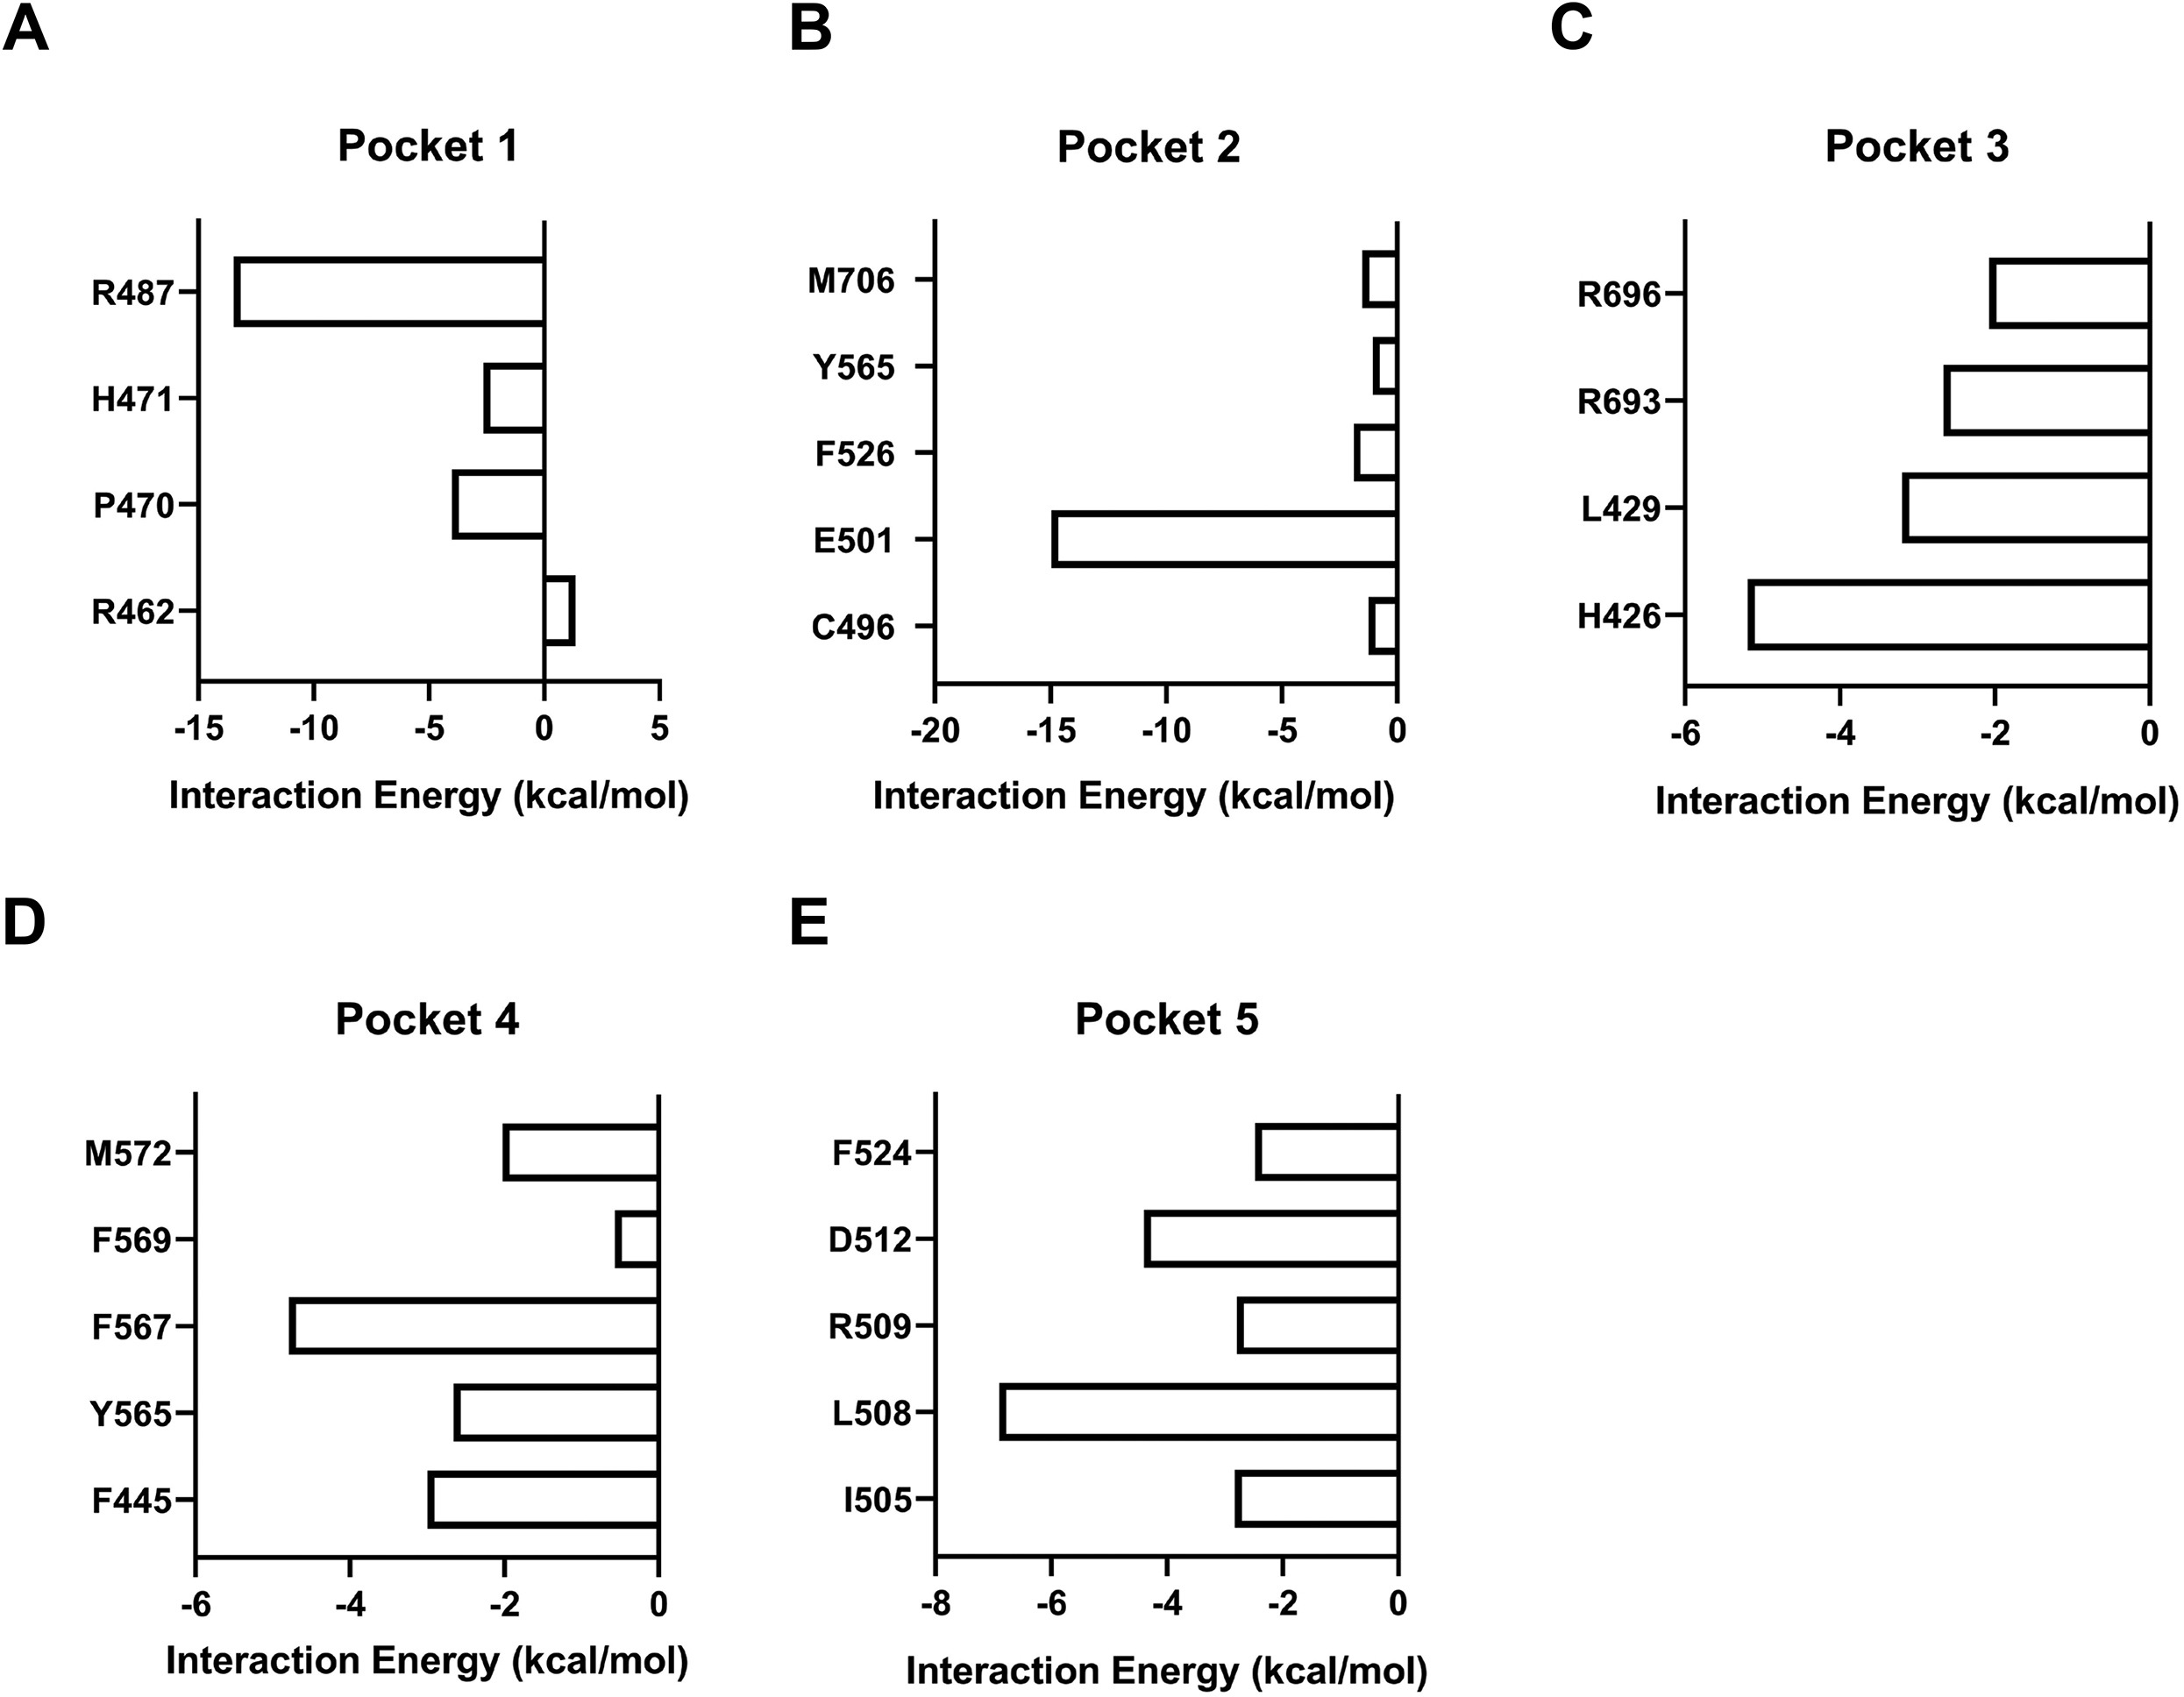
Supplemental Figure S1
Journal of Biological Chemistry 2022 298DOI: (10.1016/j.jbc.2022.101706)
Copyright © 2022 The Authors Terms and Conditions

