Slide 1
Molecular determinants for the chemical activation of the warmth-sensitive TRPV3 channel by the natural monoterpenoid carvacrol
Canyang Niu, Xiaoying Sun, Fang Hu, Xiaowen Tang, KeWei Wang
Journal of Biological Chemistry
Volume 298 Issue 3 (March 2022)
DOI: 10.1016/j.jbc.2022.101706
Copyright © 2022 The Authors Terms and Conditions

Slide 2
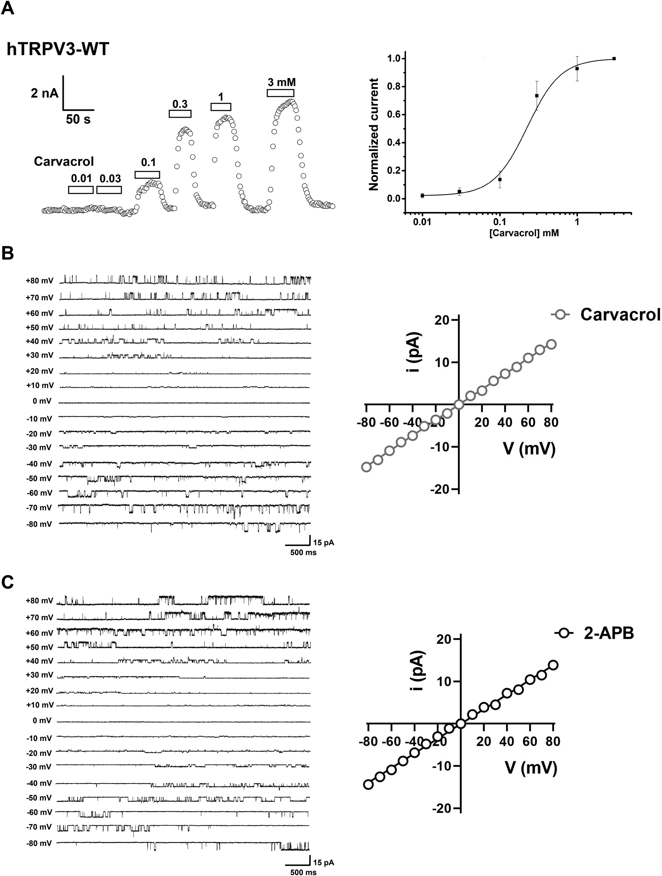
Figure 1
Journal of Biological Chemistry 2022 298DOI: (10.1016/j.jbc.2022.101706)
Copyright © 2022 The Authors Terms and Conditions
Notes:
Dose- and voltage-dependent activation of TRPV3 channel currents by carvacrol and 2-APB. A, whole-cell patch-clamp recordings of TRPV3 currents in response to different concentrations of carvacrol ranging from 0.01 to 3.0 mM with an EC50 of 215.0 ± 47.94 μM (n = 6). B, left panel, representative single-channel current (inside-out patches) traces induced by depolarizing potentials from −80 mV to +80 mV in the presence of carvacrol (300 μM); right panel, the I-V relationship of TRPV3 single-channel currents evoked by carvacrol (gray circles) with a unitary conductance of 182.0 ± 6.4 pS (n = 4) obtained by fitting a linear function. C, left panel, representative single-channel current (inside-out patches) traces in response to depolarizing potentials from −80 mV to +80 mV in the presence of 2-APB; right panel, the I-V relationship of TRPV3 single-channel currents in response to 50 μM 2-APB (black circles) with a unitary conductance of 173.2 ± 5.3 pS (n = 4) obtained by fitting a linear function. All statistical data are expressed as the mean ± SD. 2-APB, 2-aminoethyl diphenylborinate; TRPV3, Transient receptor potential vanilloid 3.

Slide 3
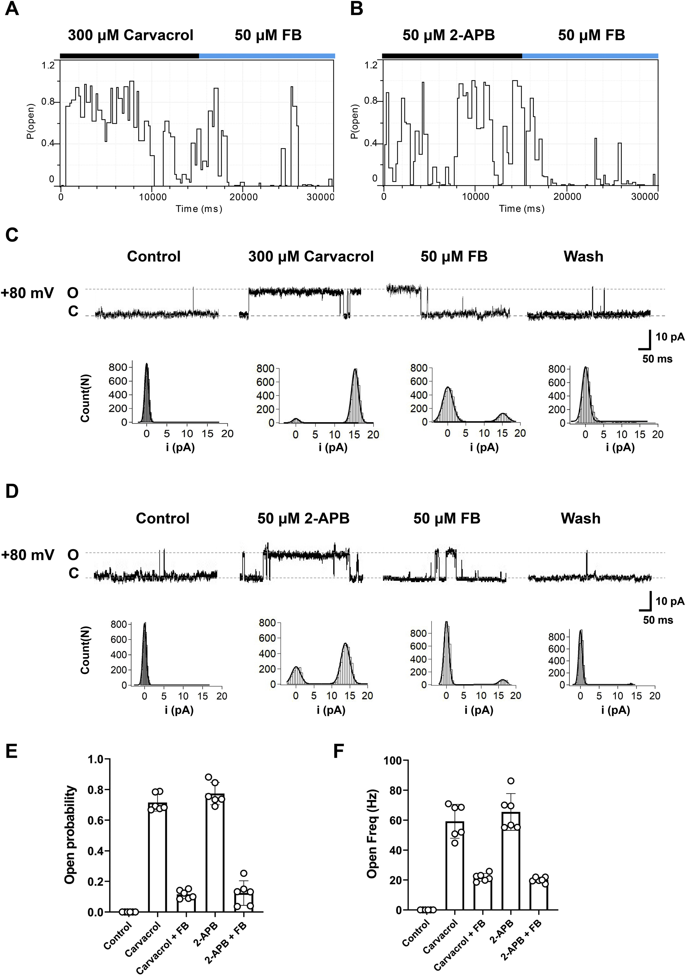
Figure 2
Journal of Biological Chemistry 2022 298DOI: (10.1016/j.jbc.2022.101706)
Copyright © 2022 The Authors Terms and Conditions
Notes:
The increase of single TRPV3 channel open probability by carvacrol. A and B, plots of time course for Po of single TRPV3 channels recorded from inside-out macropatches (at +80 mV) in the presence of 300 μM carvacrol or 50 μM 2-APB before the addition of 50 μM TRPV3 blocker forsythoside B (FB). C and D, representative single-channel current traces recorded at +80 mV before and after the addition of 300 μM carvacrol (C) or 50 μM of 2-APB (D) with or without 50 μM TRPV3 blocker FB before washout. All-point amplitude histograms of single-channel currents were shown in their lower panels. Letters O and C indicate channel open state and closed state, respectively. E and F, summary for effects of carvacrol and 2-APB on TRPV3 single-channel open probability (left) and open frequency (Freq) (right) in the presence or absence of FB. All statistical data are expressed as the mean ± SD. 2-APB, 2-aminoethyl diphenylborinate; Po, open probability; TRPV3, Transient receptor potential vanilloid 3.

Slide 4
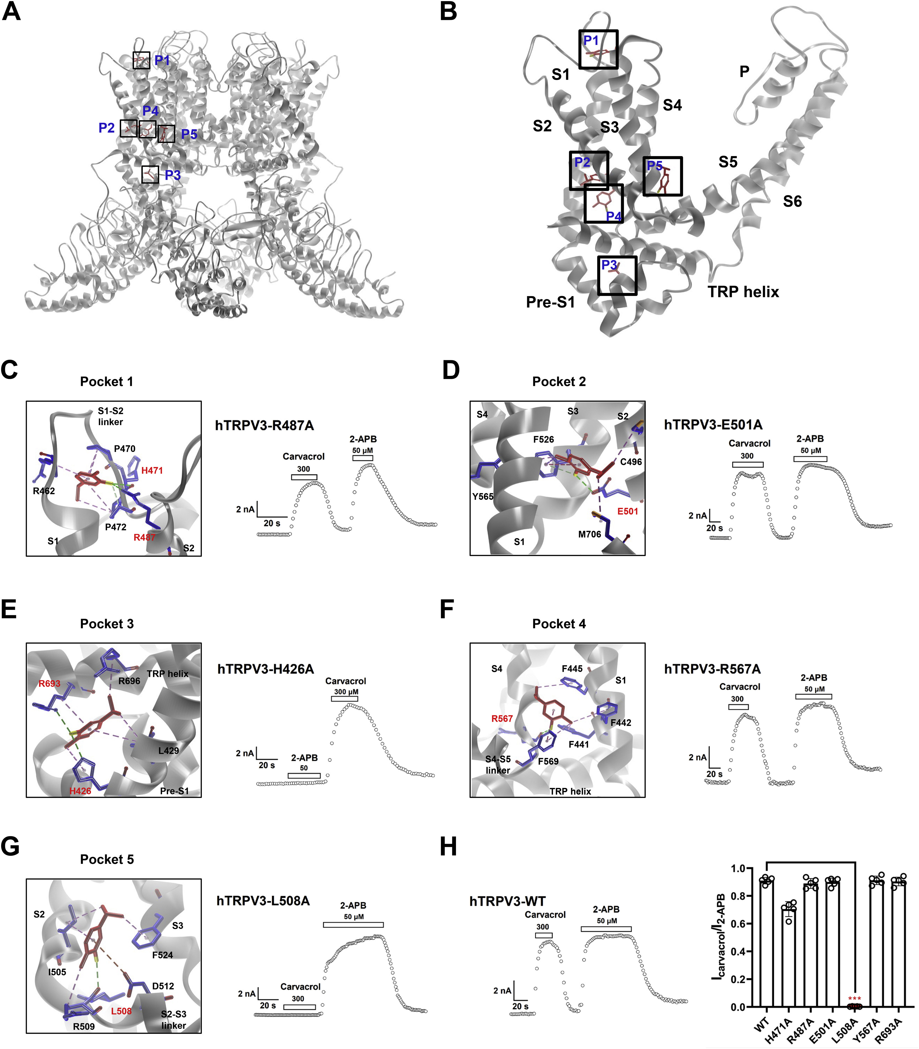
Figure 3
Journal of Biological Chemistry 2022 298DOI: (10.1016/j.jbc.2022.101706)
Copyright © 2022 The Authors Terms and Conditions
Notes:
Identification of a binding pocket formed by S2-S3 linker critical for interaction between carvacrol and TRPV3. A, an overview of putative five pockets for carvacrol binding to TRPV3 structure from docking. B, a representative view showing the binding of carvacrol to one subunit of TRPV3 in the five binding pockets (P1–5). C, left panel, carvacrol in the binding pocket 1 with putative interaction residues; right panel, representative TRPV3-H487A whole-cell currents in response to 300 μM carvacrol or 50 μM 2-APB. D, left panel, carvacrol in the binding pocket 2 with putative interaction residues; right panel, representative TRPV3-E501A whole-cell currents in response to 300 μM carvacrol and 50 μM 2-APB. E, left panel, carvacrol in the binding pocket 3 with putative interaction residues; right panel, representative TRPV3-H426A whole-cell currents in response to 300 μM carvacrol or 50 μM 2-APB. F, left panel, carvacrol in the binding pocket 4 with putative interaction residues; right panel, representative TRPV3-R567A whole-cell currents in response to 300 μM carvacrol or 50 μM 2-APB. G, left panel, carvacrol in the binding pocket 5 with putative interaction residues; right panel, representative TRPV3-L508A whole-cell currents in response to 300 μM carvacrol and 50 μM 2-APB. H, left panel, representative WT TRPV3 whole-cell currents in response to 300 μM carvacrol or 50 μM 2-APB; right panel, a summary of normalized currents for the comparison of activation of WT TRPV3 and mutant channels by carvacrol (n = 5, ∗∗∗p < 0.001). Carvacrol in a schematic structure is shown in red and molecular residues involved are shown in blue. Key amino acids are labeled in red font. All data are expressed as the mean ± SD. 2-APB, 2-aminoethyl diphenylborinate; TRPV3, Transient receptor potential vanilloid 3.

Slide 5
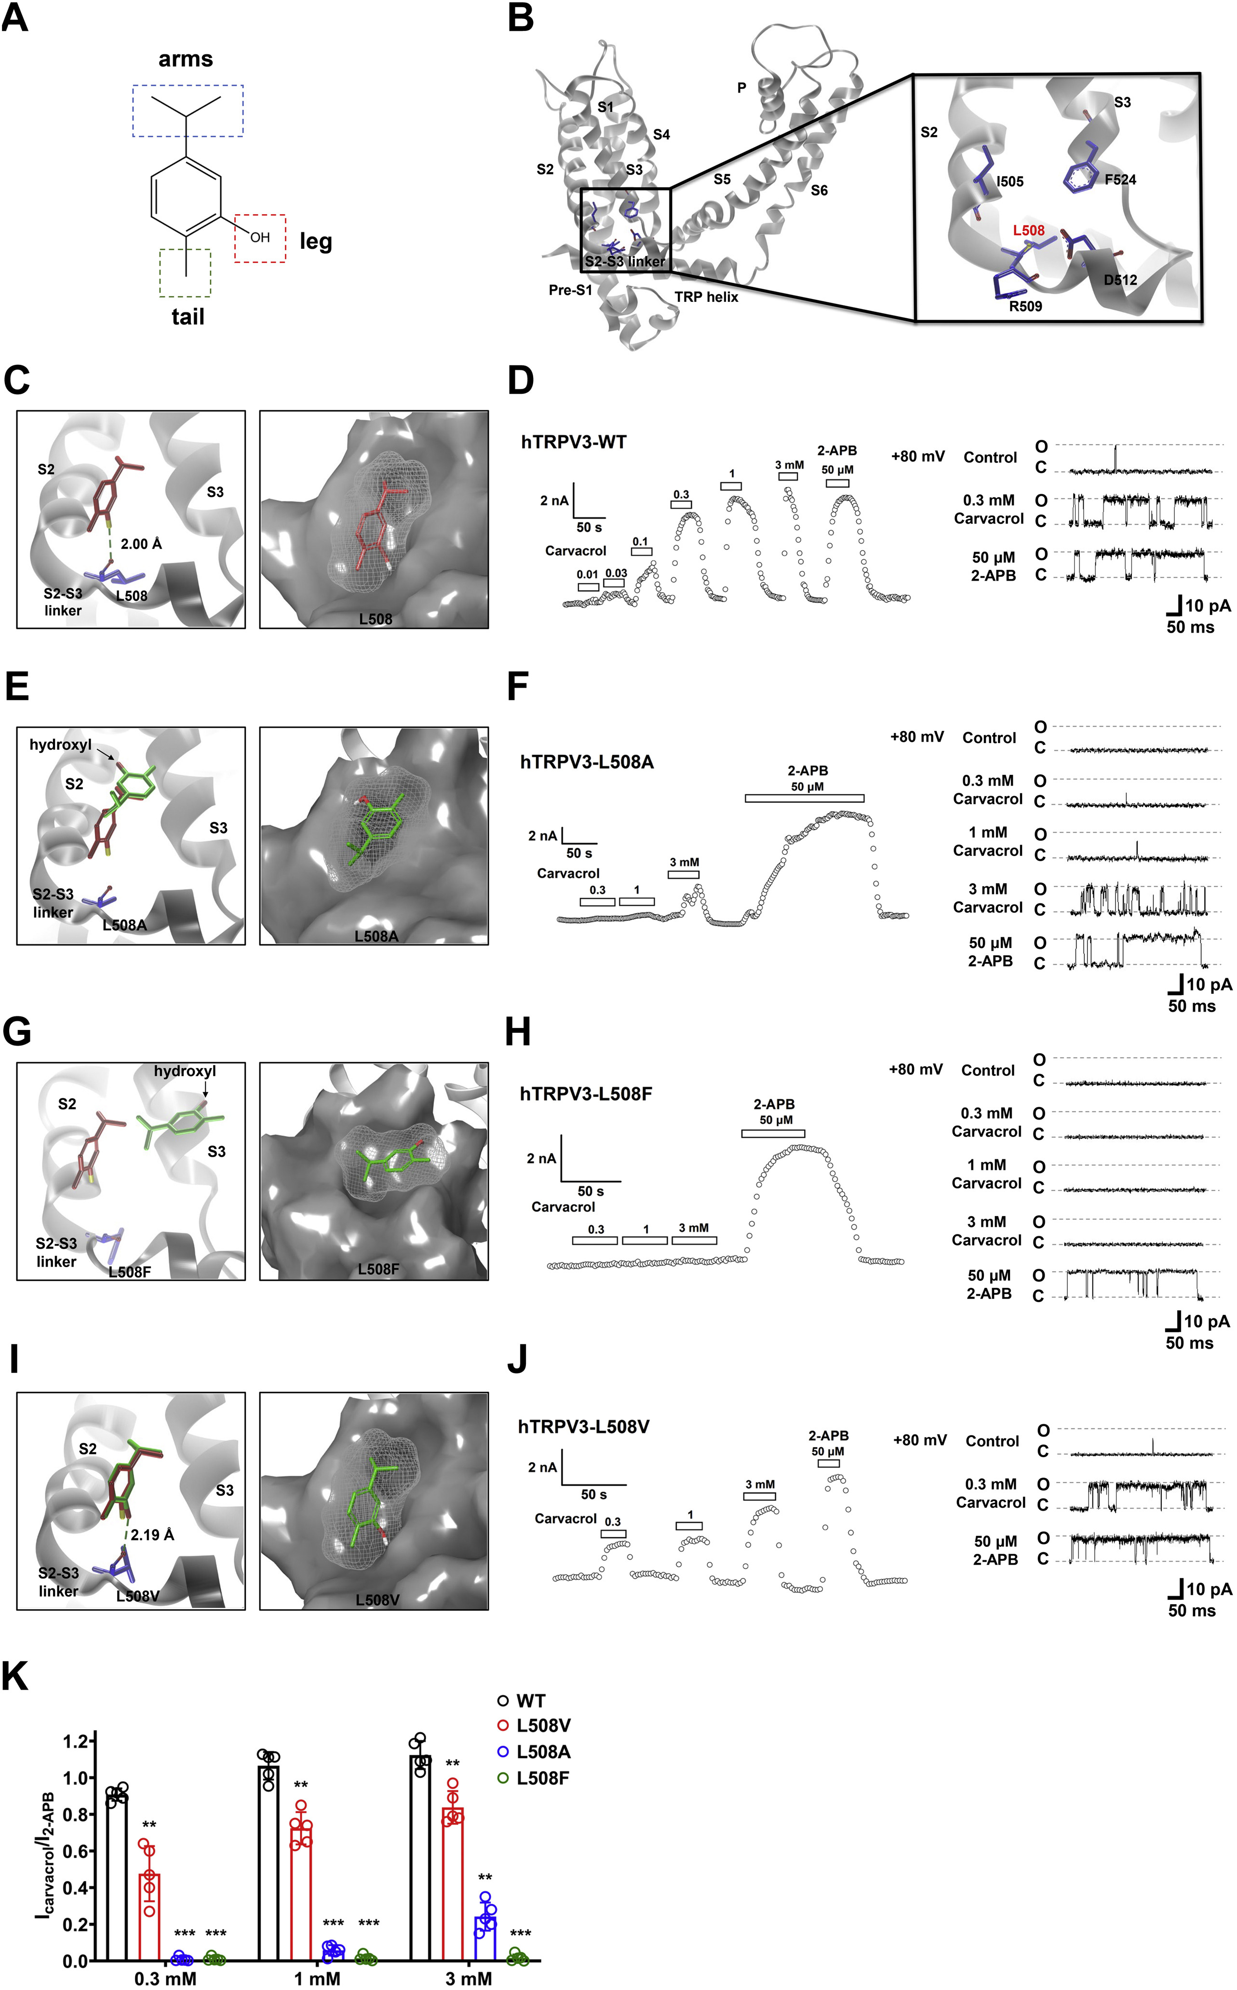
Figure 4
Journal of Biological Chemistry 2022 298DOI: (10.1016/j.jbc.2022.101706)
Copyright © 2022 The Authors Terms and Conditions
Notes:
Confirmation of residue L508 in the pocket 5 critical for carvacrol-mediated activation of TRPV3. A, the chemical structure of carvacrol featuring the moieties of an isopropyl group with two-methyl arms, a hydroxyl leg, and a methyl tail. B, an overview of one subunit and its zoom-in view of the binding pocket formed by residues L505, L508, R509, D512, and F524. C, left panel, docking predicts a hydrogen bond between the hydroxyl leg of carvacrol (in red) and the residue L508 (in blue); right panel, a representative surface binding posture of carvacrol (in red) in the pocket of TRPV3 S2-S3. D, left panel, concentration-dependent activation of WT TRPV3 currents by carvacrol in whole-cell recordings and single-channel current traces (right panel) (n = 5). E, left panel, virtual mutation of TPRV3-L508A in docking with carvacrol (in green) altering the binding mode in the pocket; right panel, a representative surface binding posture of carvacrol (in green) in the pocket. F, representative whole-cell current recordings of TRPV3-L508A (left panel) and single-channel current traces (right panel) in response to different concentrations (0.3–3.0 mM) of carvacrol or 50 μM 2-APB (n = 5). G, left panel, virtual mutation of TPRV3-L508F in docking with carvacrol (in green) altering the binding mode in the pocket; right panel, a representative surface binding posture of carvacrol (in green) in the pocket. H, representative whole-cell current recordings of TRPV3-L508F (left panel) and single-channel current traces (right panel) in response to different concentrations (0.3–3.0 mM) of carvacrol or 50 μM 2-APB (n = 5). I, left panel, virtual mutation of TPRV3-L508V in docking with carvacrol (in green), altering the binding mode in the pocket; right panel, a representative surface binding posture of carvacrol (in green) in the pocket. J, left panel, concentration-dependent activation of TRPV3-L508V currents by carvacrol in whole-cell recordings and single-channel current traces (right panel) (n = 5). K, a summary of normalized currents for concentration-dependent activation of WT TRPV3 and its mutant channels by carvacrol (0.3–3 mM) (n = 5). The dominant conformations of carvacrol in WT TRPV3 and mutants are shown in red sticks and green sticks, respectively. Gray surface area indicates the density of TRPV3 and light gray mesh shows the density of carvacrol. All data are expressed as the mean ± SD, ∗∗p < 0.01, ∗∗∗p < 0.001, by unpaired t test. 2-APB, 2-aminoethyl diphenylborinate; TRPV3, Transient receptor potential vanilloid 3.

Slide 6
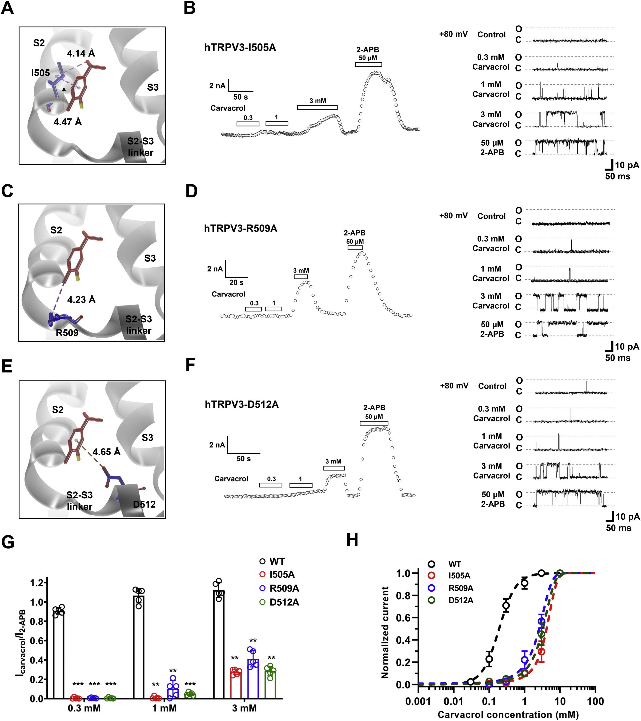
Figure 5
Journal of Biological Chemistry 2022 298DOI: (10.1016/j.jbc.2022.101706)
Copyright © 2022 The Authors Terms and Conditions
Notes:
Molecular determinants in the binding pocket of S2-S3 critical for activation of TRPV3 by carvacrol. A, molecular docking showing alkyl–alkyl & π–alkyl interactions between isopropyl arms and aromatic core of carvacrol and residue I505. B, representative whole-cell current recordings of TRPV3-I505A (left panel) and single-channel current traces (right panel) in response to different concentrations (0.3–3.0 mM) of carvacrol or 50 μM 2-APB (n = 5). C, molecular docking showing alkyl–alkyl interaction between methyl tail of carvacrol and residue R509. D, representative whole-cell current recordings of TRPV3-R509A (left panel) and single-channel current traces (right panel) in response to different concentrations (0.3–3.0 mM) of carvacrol or 50 μM 2-APB (n = 5). E, molecular docking showing π–anion interaction between carvacrol and residue D512. F, representative whole-cell current recordings of TRPV3-D512A (left panel) and single-channel current traces (right panel) in response to different concentrations (0.3–3.0 mM) of carvacrol or 50 μM 2-APB (n = 5). G, a summary of normalized currents for concentration-dependent activation of WT TRPV3 and mutant channels by carvacrol (0.3–3 mM) (n = 5). H, a summary for the comparison of concentration–response curves of activation of WT and mutant TRPV3 currents by carvacrol (n = 5). Dotted lines are fits to Hill equation, yielding WT TRPV3 with EC50 of 0.18 ± 0.03 mM (n = 5). Mutations I505A, R509A, and D512A showed EC50 values with 3.51 ± 0.44 mM, 2.93 ± 0.11 mM, and 3.21 ± 0.48 mM, respectively (n = 5). All data are expressed as the mean ± SD, ∗∗p < 0.01, ∗∗∗p < 0.001, by unpaired t test. 2-APB, 2-aminoethyl diphenylborinate; TRPV3, Transient receptor potential vanilloid 3.

Slide 7
Figure 6
Journal of Biological Chemistry 2022 298DOI: (10.1016/j.jbc.2022.101706)
Copyright © 2022 The Authors Terms and Conditions
Notes:
Proposed model for binding of S2-S3 and activation of TRPV3 channel by carvacrol. Carvacrol-mediated activation of TRPV3 channels involves the ligand binding and channel opening. Carvacrol binding to S2-S3 linker leads to conformational changes that propagate from the channel periphery to the channel pore opening. TRPV3, Transient receptor potential vanilloid 3.

Slide 8
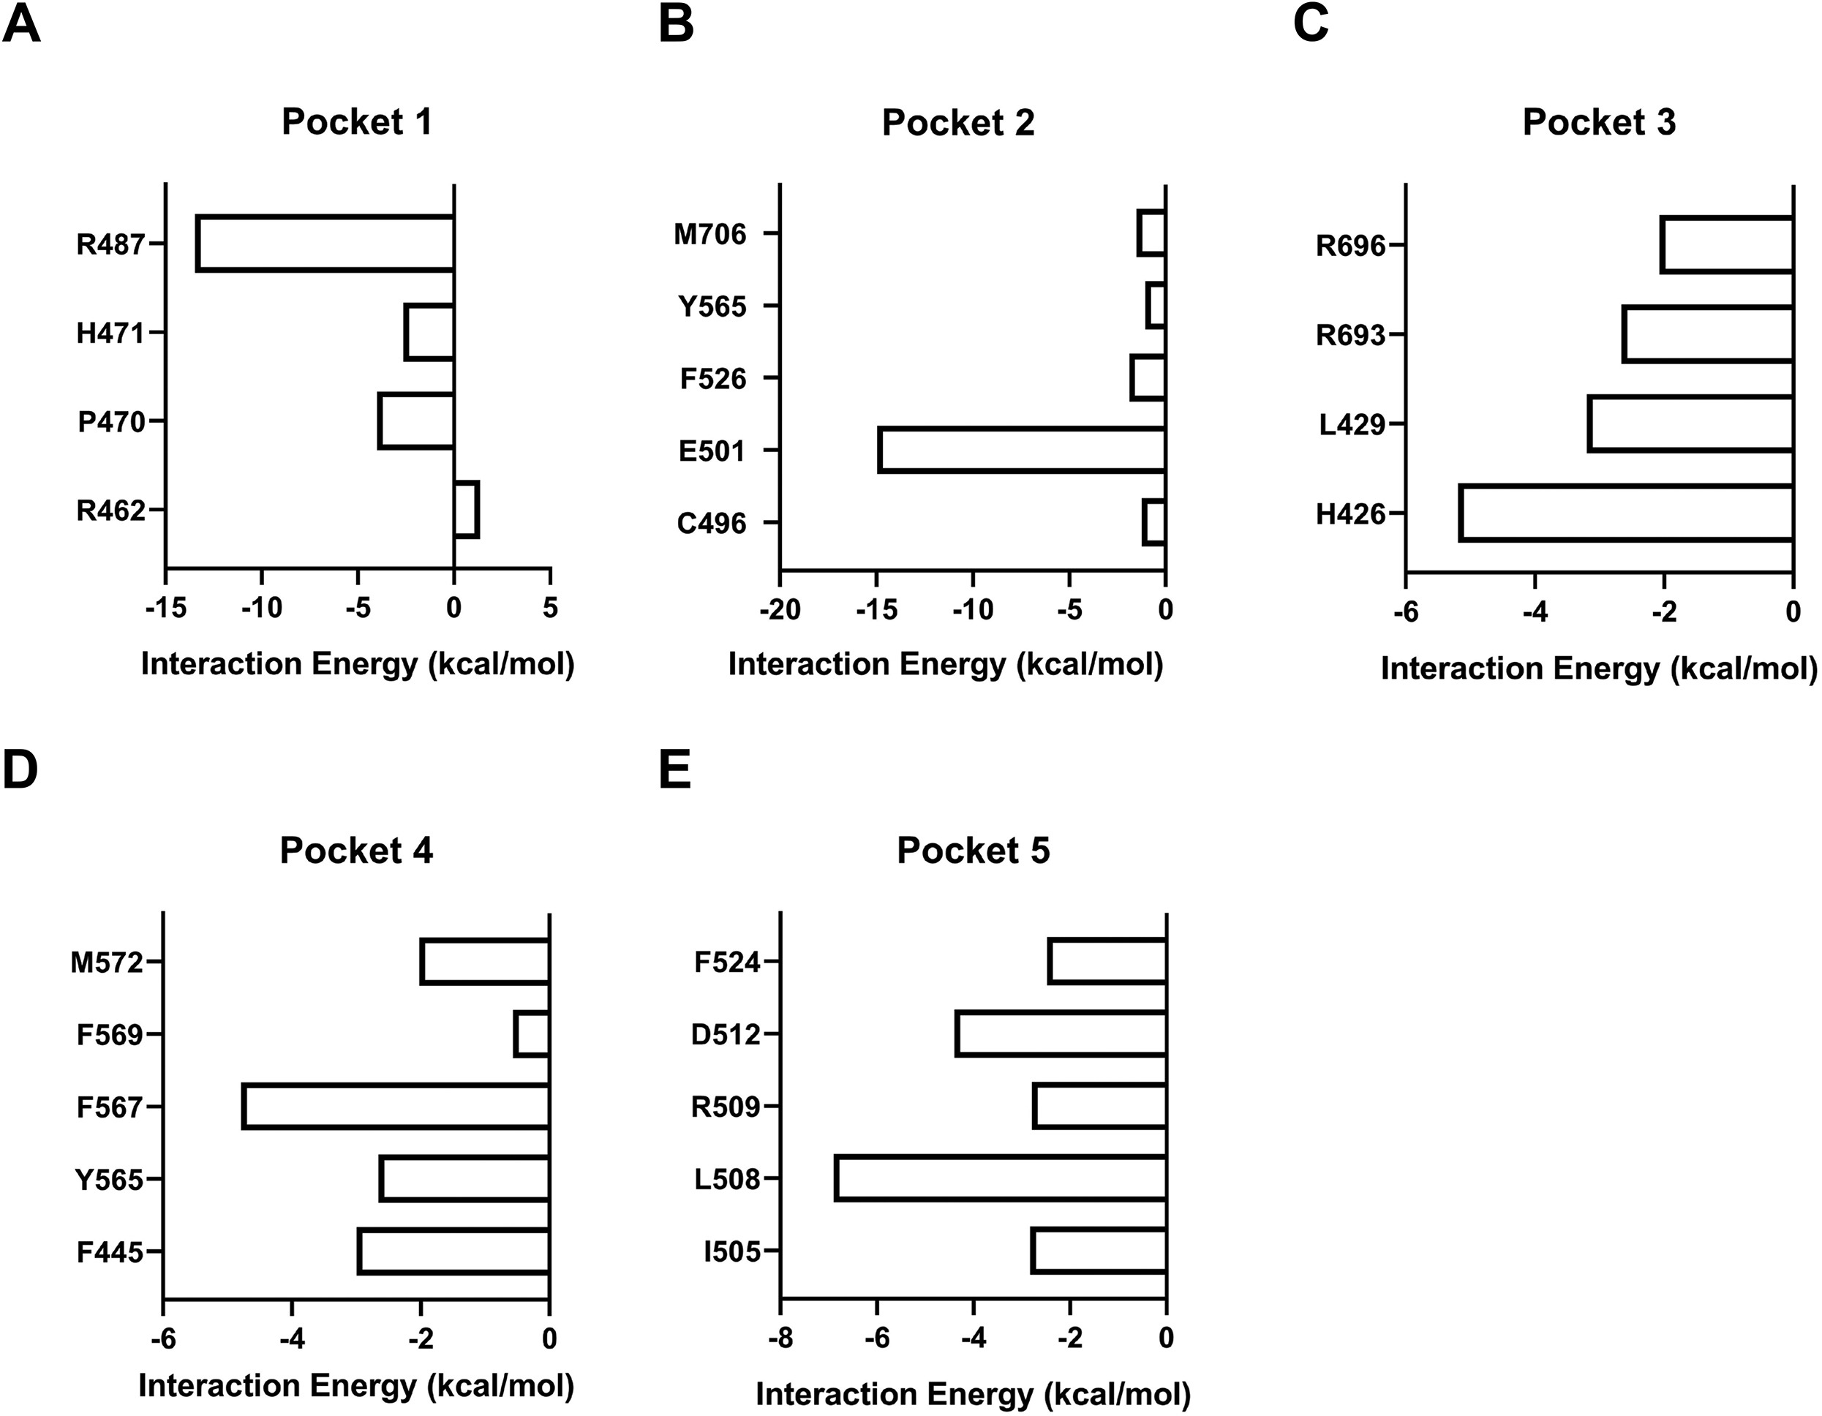
Supplemental Figure S1
Journal of Biological Chemistry 2022 298DOI: (10.1016/j.jbc.2022.101706)
Copyright © 2022 The Authors Terms and Conditions

Slide 9
Supplemental Figure S2
Journal of Biological Chemistry 2022 298DOI: (10.1016/j.jbc.2022.101706)
Copyright © 2022 The Authors Terms and Conditions

